Slide 1
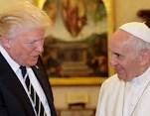
Pope Francis shocks
world, endorses
Donald Trump for
President!

Slide 2
Trust in the Lord with all your heart and lean not on your own understanding; in all your ways submit to him, and he will make your paths straight.
Proverbs 3:5

Slide 3
Do you see a person wise in their own eyes? There is more hope for a fool than for them.
Proverbs 26:12

Slide 4
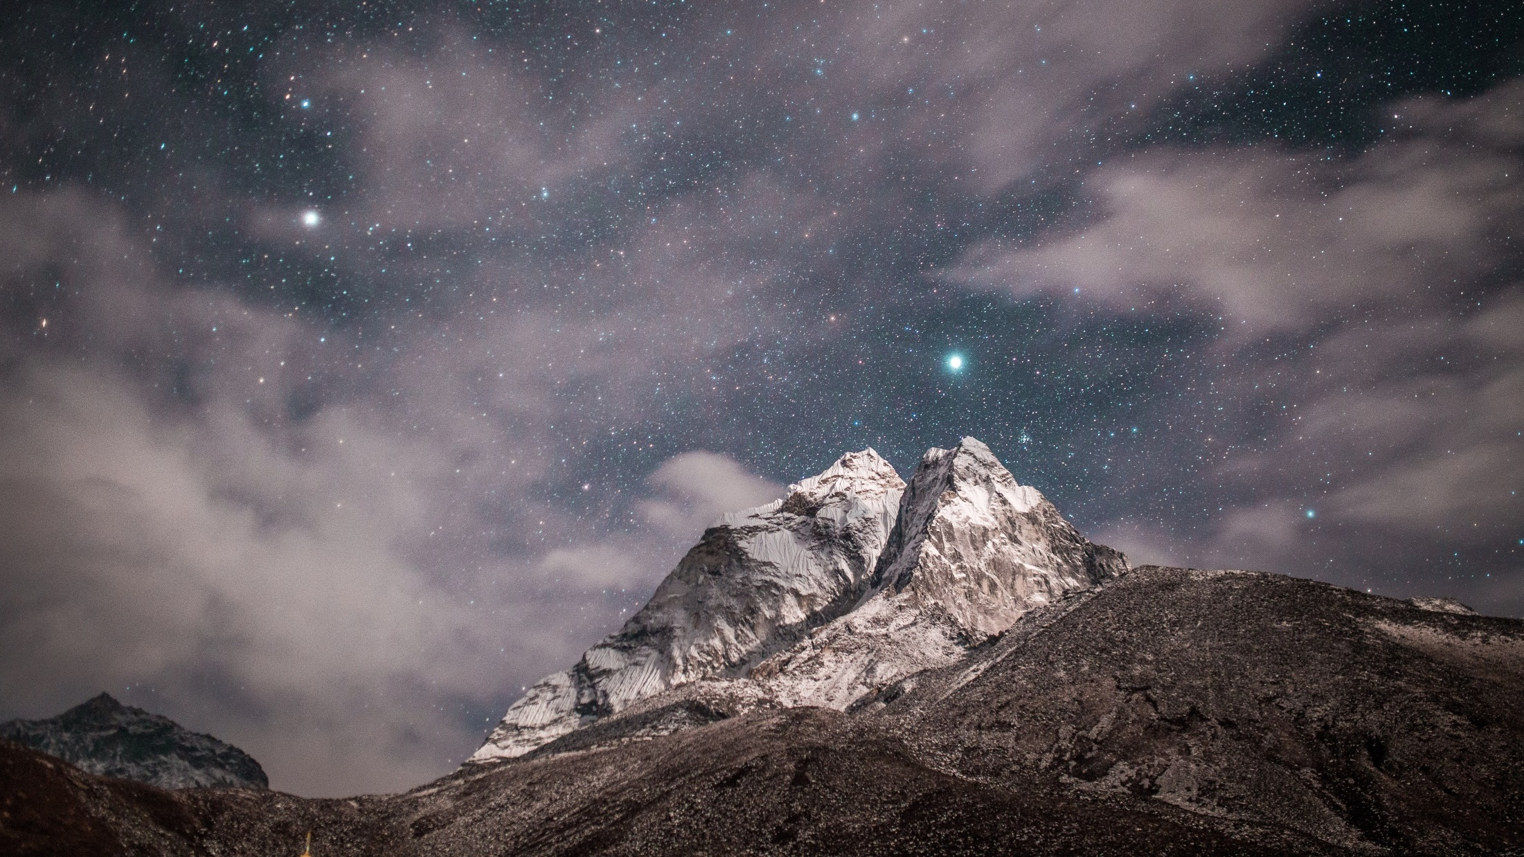
Naturally Supernatural

Slide 5
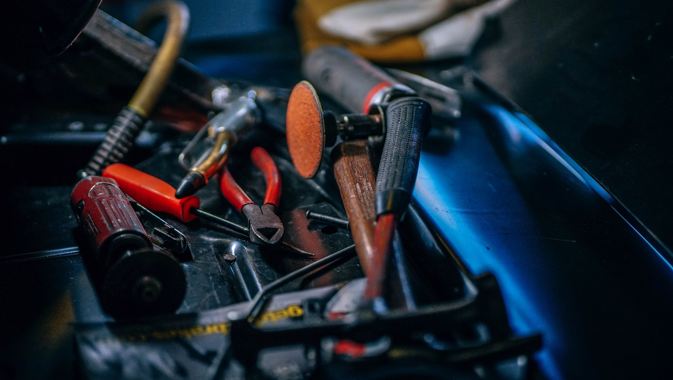

Slide 6
1 Corinthians 12: 7-11 (NIV)
⁷ Now to each one the manifestation of the Spirit is given for the common good. ⁸ To one there is given through the Spirit a message of wisdom, to another a message of knowledge by means of the same Spirit,

Slide 7
1 Corinthians 12: 7-11 (NIV)
⁹ to another faith by the same Spirit, to another gifts of healing by that one Spirit, ¹⁰ to another miraculous powers, to another prophecy, to another distinguishing between spirits,

Slide 8
1 Corinthians 12: 7-11 (NIV)
to another speaking in different kinds of tongues, and to still another the interpretation of tongues. ¹¹ All these are the work of one and the same Spirit, and he distributes them to each one, just as he determines.

Slide 9
“Mouth of God”
“Eyes of God”
“Hands of God”

Slide 10
Knowing gifts:
Wisdom
Knowledge
Discernment

Slide 11
Wisdom
The Holy Spirit plumbs the depths of God’s mind and shares his wisdom with us.

Slide 12
Knowledge
Spirit inspired insight
Revelation about a person or a situation

Slide 13
Discernment
Seeing the Spirit at work in someone or somewhere
Weigh prophecies
Recognise who’s speaking

Slide 14
The knowing gifts
Make God known
Make God visible in our lives and the lives of others

Slide 15
The knowing gifts
Build up the church
Are part of life outside church

Slide 16
A life full of the everyday supernatural
is life full of acts of divine power
that reveal more of God’s love.
Everyday Supernatural by Mike Pilavachi & Andy Croft

Slide 17
The knowing gifts
Build up the church
Are part of life outside church
Make us more attractive!!

Slide 18
Receiving these gifts
Trust
Ask
Do what Jesus tells us

Slide 19
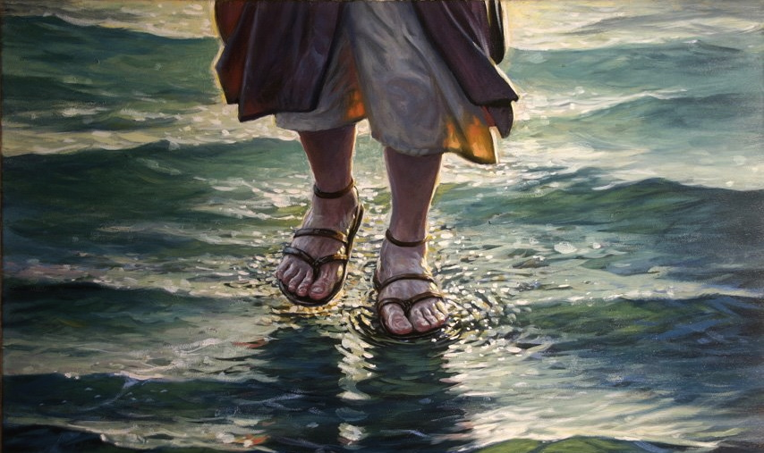

Slide 20
Sun. 26/11 – personal prophecy
Fri 1/12 – experience more…..

Slide 21
Naturally Supernatural

